Slide 1
Real Estate Price Prediction Using Machine Learning Algorithms
ASWIN SIVAM RAVIKUMAR
X16134621

Slide 2




Is it possible to predict the real estate house predictions effectively using Machine learning algorithms in advanced data mining tools
R PROGRAM
RAPID MINER
WEKA

Slide 3
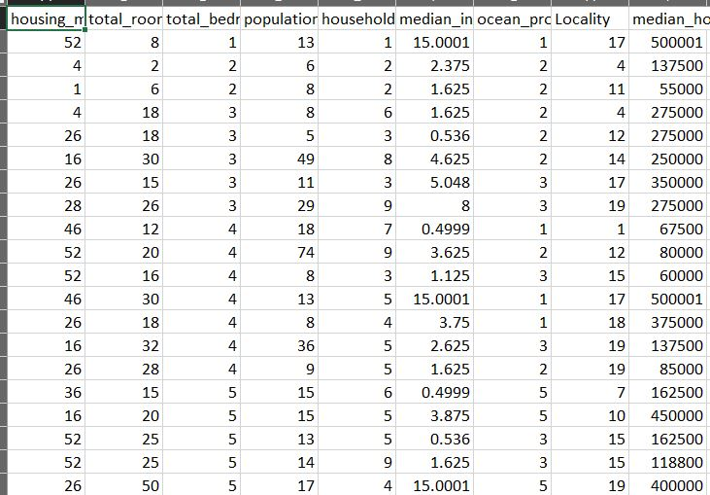
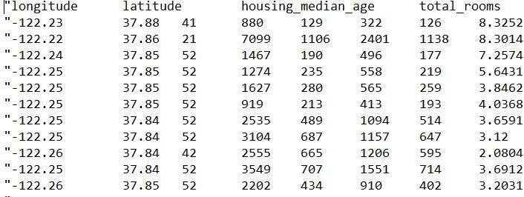
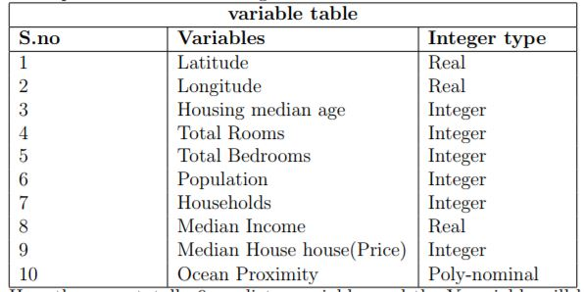
Data set
From UCI and github

Slide 4
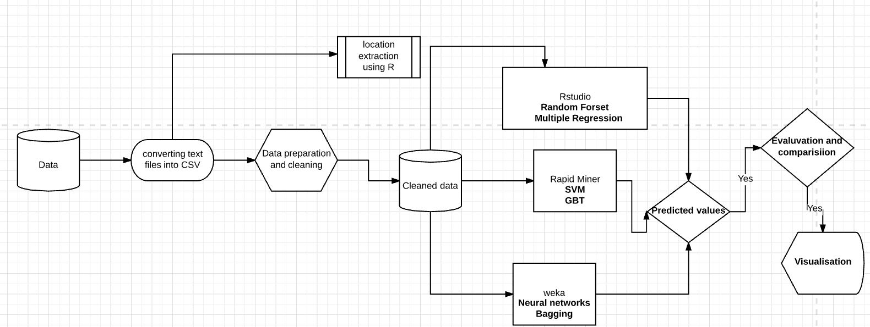

Slide 5
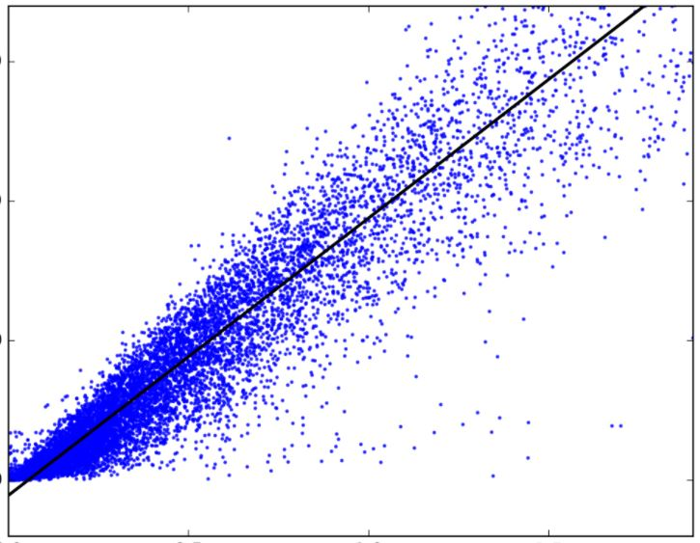
Regression
regression analysis estimates the relationship between two or more variables.
It indicates the significant relationships between dependent variable and independent variable.
It indicates the strength of impact of multiple independent variables on a dependent variable.
Used to predict the next variables with the help of existing attributes.

Slide 6
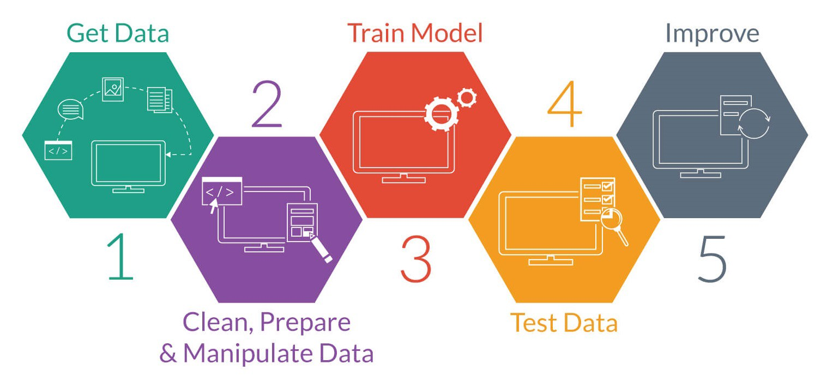
ML Algorithms used
Random forest
Multiple regression
Support vector machine
Gradient boosted trees
Multi layer perceptron
bagging

Slide 7
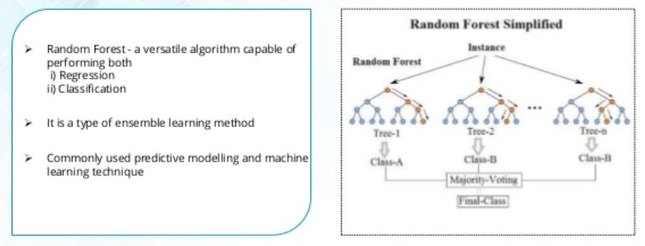
Random forest and multiple regression
Random forest
Constructing multiple decision trees at training time and outputting the mean prediction of induvial trees.
Multiple Regression
It is used when we want to predict the value of a variable based on the value of two or more other variables.

Slide 8
Support vector machine, Gradient boosted trees
SVM Supervised learning method
we plot each data item as a point in n-dimensional space with the value of each feature being the value of a particular coordinate.
Finding the right hyperplane.
GBT is to compute sequence of simple trees .
Binary trees which means data will be partition into 2 samples in each split node.

Slide 9
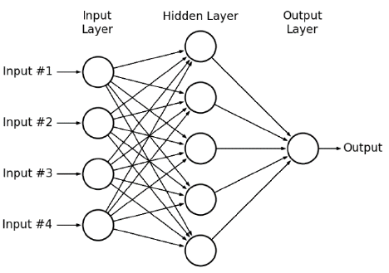
Multilayer perceptron, Bagging
Collection of nodes and arrows.
Computation flows through the arrows
N from n
Arrow – weights – strength of connection
All node values * weights and sums – passes to active function checks op in range -1 to 1.
Hidden layer nodes and arrows can be in any way, MLP groups nodes into layers .
Each node in layer I takes all nodes i-1 layer as input and rest remains hidden layers.
Here the main aim is to create a sample from train data, for the prediction here it uses the trained algorithm and its one of the simplest approach. MULTIPLE MODELS ARE BUILT AND ALL.

Slide 10
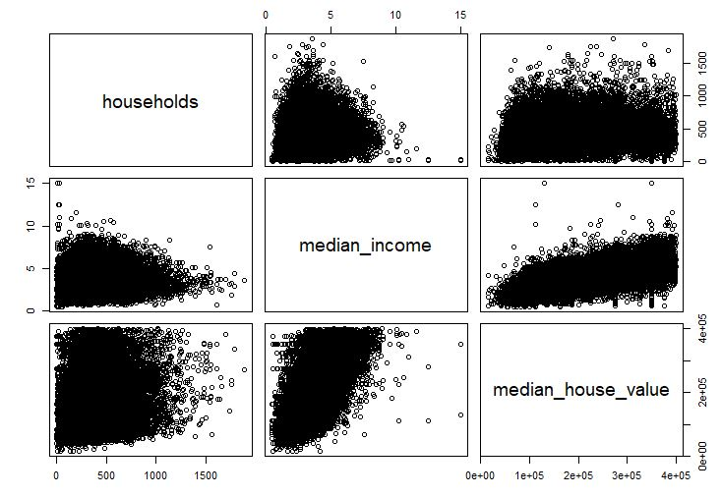
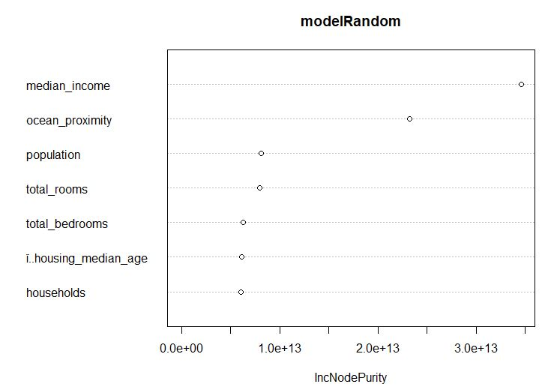
R program
LIBRARIES USED
Random forest
Nlme
caTools
Ggmap
Normalization check
Avoiding dummy variable trap
Train – 75%
Test – 25%
Trees used -200
Mtry -3
Variable importance
Prediction
RMSE

Slide 11
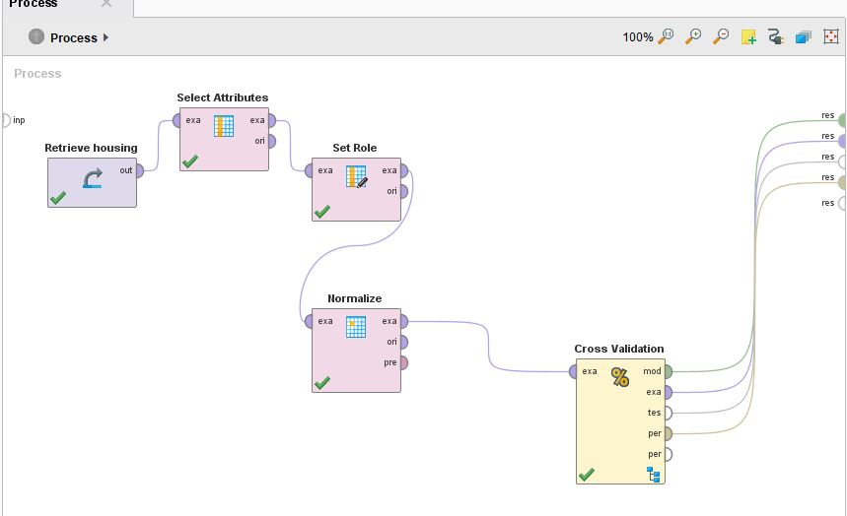
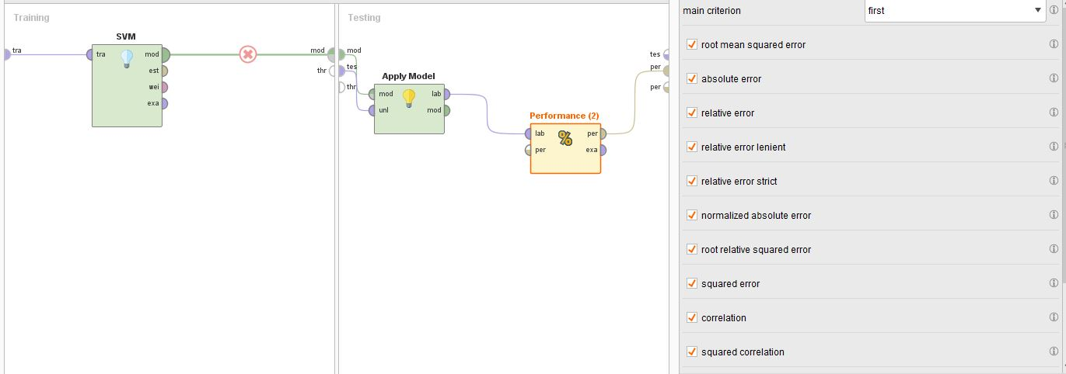
RAPID MINER
SUPPORT VECTOR MACHINE
GRADIENT BOOSTED TREES

Slide 12
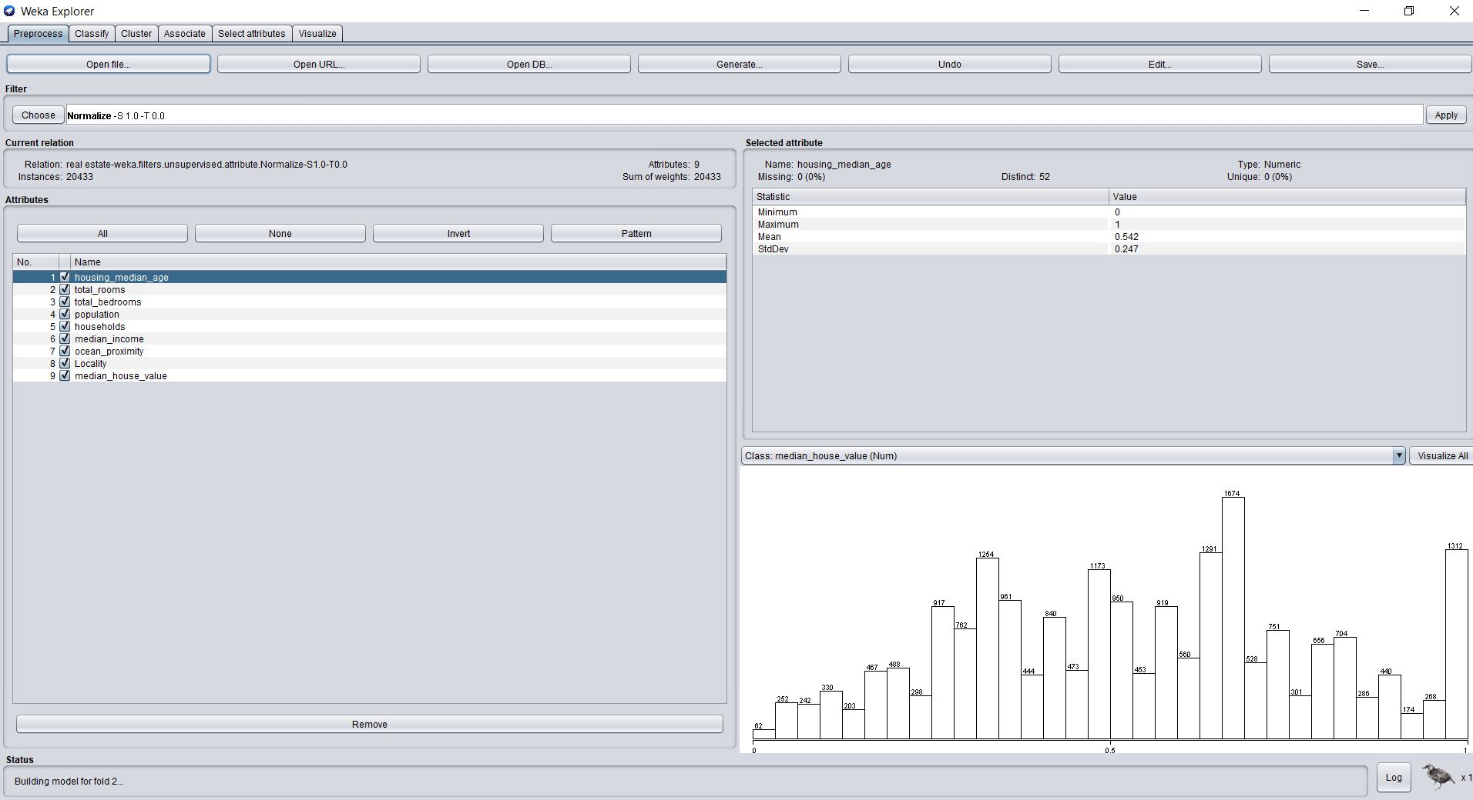
WEKA Multi layer perceptron Bagging

Slide 13
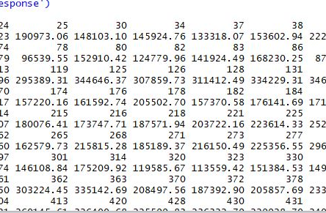
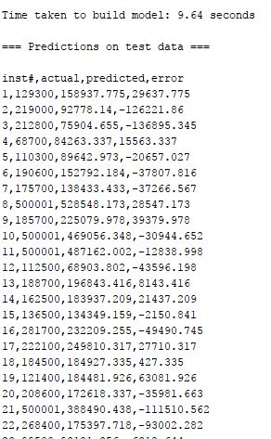
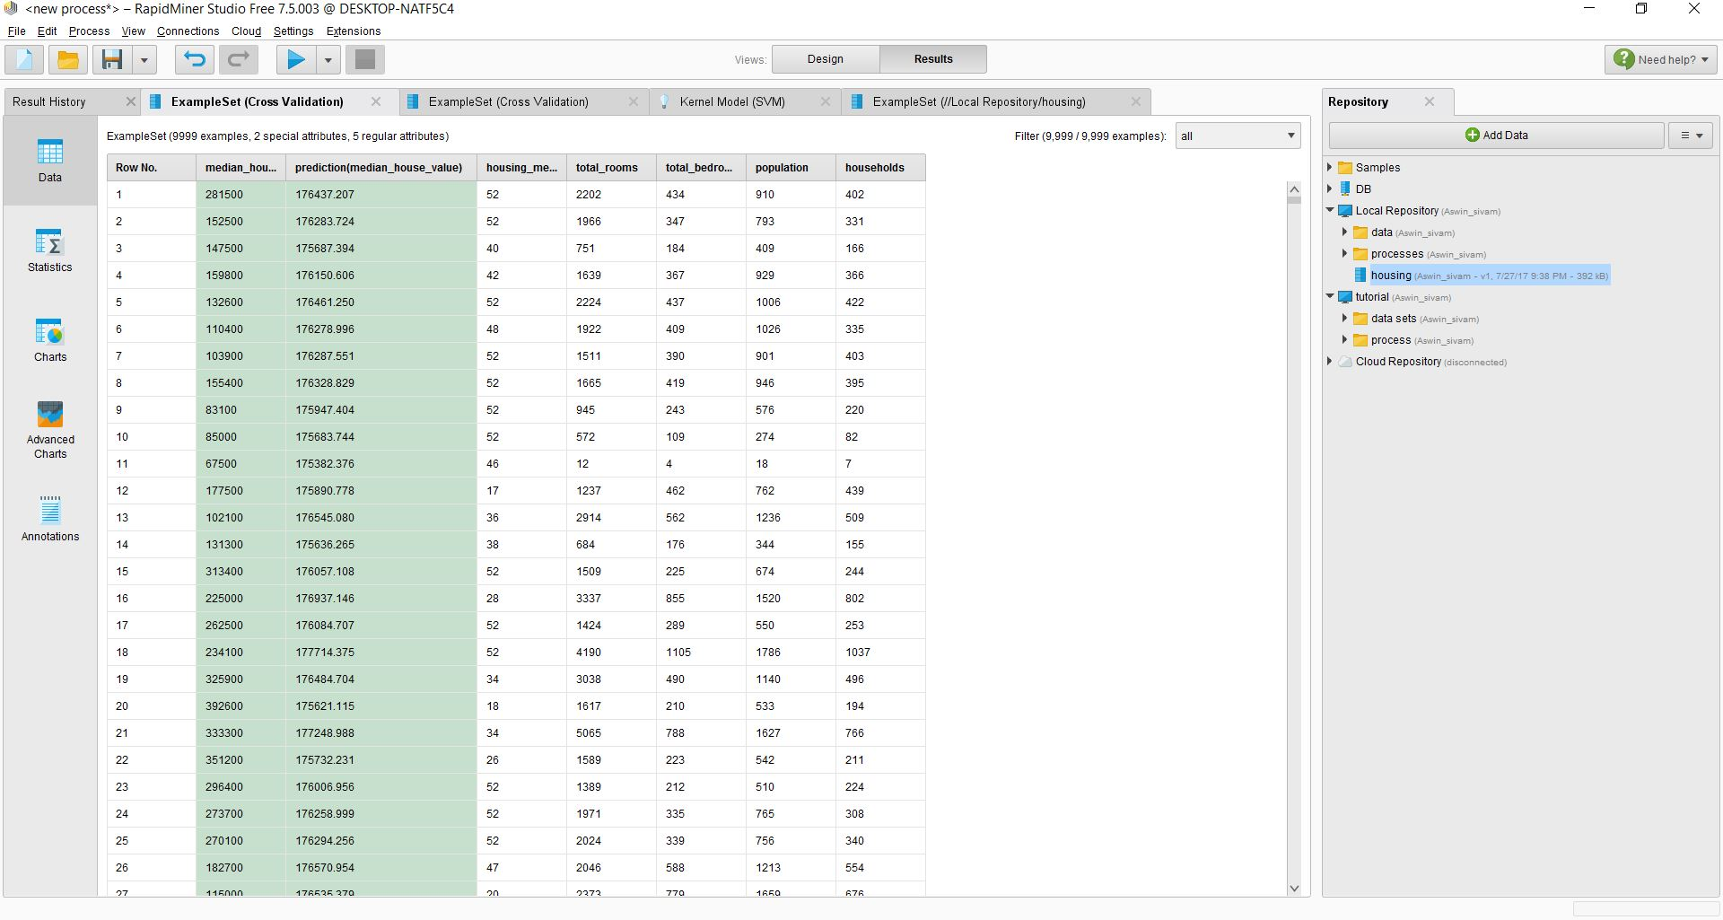
PREDECTIED
values

Slide 14
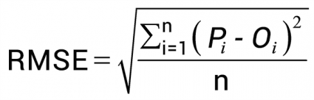
RMSE AND R SQUARE
ROOT MEAN SQUARE ERROR
Predicted value – actual value by no of instances in data set
R square determines how close data fitted into regression line.
Ssr/sst

Slide 15
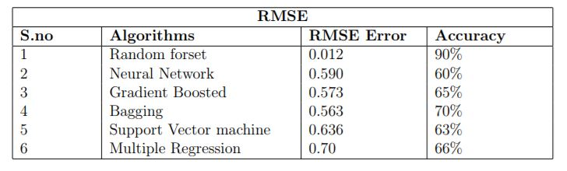
EVALUVATION

Slide 16
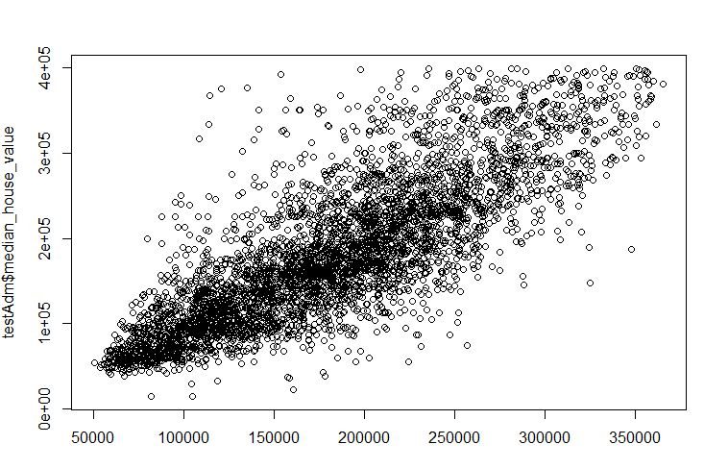
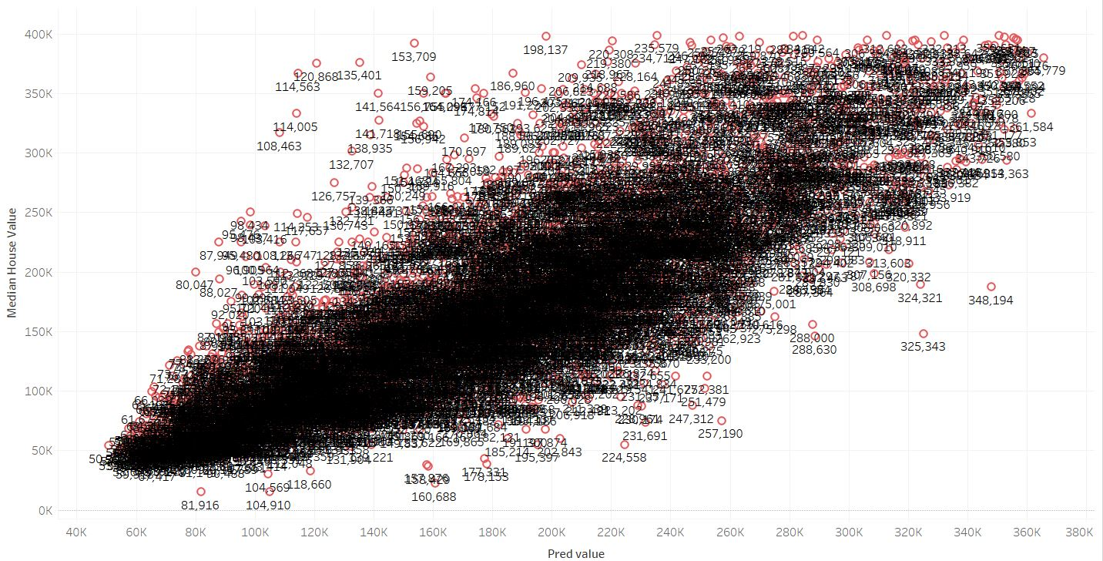
VISUALIZATION
Tableau

Slide 17
Future
Mobile app
Real time data
H20 AI
Application environment
WORKS

Slide 18
THANK YOU

